Slide 1
Seat Position Effects on Metabolic Energy Expenditure Rate While Cycling
1 March 2021
Chelsea Chen, Cait Clancy, David Gonzalez, Sepehr Rostamzadeh
ME 329
Notes:
CC

Slide 2
Problem Definition
& Context
Notes:
CC - 2 min
To recap quickly our prob def. & context...

Slide 3
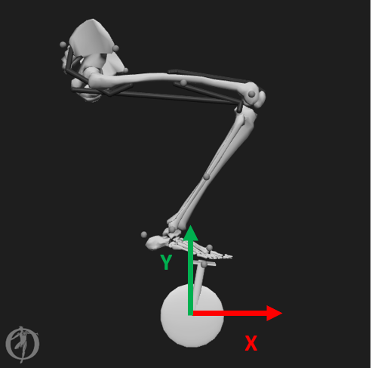
Problem Definition
Changing the seat (i.e. saddle) position (X, Y) of a bicycle can affect the power output and metabolic energy expenditure rate of the cyclist.
An optimal saddle position can be achieved when metabolic energy expenditure rate is minimized (Bini 2011, Wozniak 1991, Peveler 2011)
Metabolic energy expenditure rate is proportional to the sum of the resting metabolic expenditure rate and the ATP consumption rate of each muscle (Tsianos 2016)c data.
Notes:
CC
We are trying to determine how seat position, defined by the x and y distance in meters from the bottom bracket of the bike, affects metabolic energy expenditure rate. We know from literature that an optimal saddle position is achieved when metabolic energy expenditure rate is minimized. Where metabolic energy expenditure rate is defined as the energy expenditure of the system proportional to the sum of the resting metabolic expenditure rate and the ATP consumption rate of each muscle.
Determining this relationship, specifically determining the optimal saddle positions in which the energy expenditure is minimized, is an area of interest for the cycling company, Specialized, who work with elite cyclists

Slide 4
Problem Definition
This project seeks to determine the optimal saddle positions for which metabolic energy expenditure rate is minimized while cycling.
Notes:
CC
And so, this projects seeks to determine which saddle positions minimize metabolic energy expenditure rate while cycling

Slide 5
Problem Definition
Using OpenSim software, we will develop an iterable model which takes in saddle position as the primary input and reports muscle-based metabolic energy expenditure rate as the primary output in order to answer the research question:
What are the optimal saddle positions (X,Y) for which metabolic energy expenditure rate is minimized?
Notes:
CC
We plan to answer our research question using OpenSim software, where we will build an iterable model of a cycling motion that takes in saddle position as primary input and reports muscle based metabolic energy expenditure rate as the primary output

Slide 6
Problem Definition
Using OpenSim software, we will develop an iterable model which takes in saddle position as the primary input and reports muscle-based metabolic energy expenditure rate as the primary output in order to answer the research question:
What are the optimal saddle positions (X,Y) for which metabolic energy expenditure rate is minimized?
Progressive Goals
Relate metabolic energy expenditure data outputs in OpenSim to an array of saddle position (X,Y) inputs using a simplified 1-leg cycling musculoskeletal model.
Develop an increasingly complex cycling musculoskeletal model (incorporating lower-leg musculature, 2 legs) to more closely approach realistic cycling conditions
Notes:
CC
And therefore our first goal is to relate metabolic energy expenditure data outputs to an array of saddle position inputs using a simplified 1 leg cycling model
And our next goal is to develop an increasingly complex model which more closely approaches realistic cycling conditions

Slide 7
Related Work
Notes:
3- CEC
We will go over a quick review of the pertinent related work and new related work relevant to our path forward

Slide 8
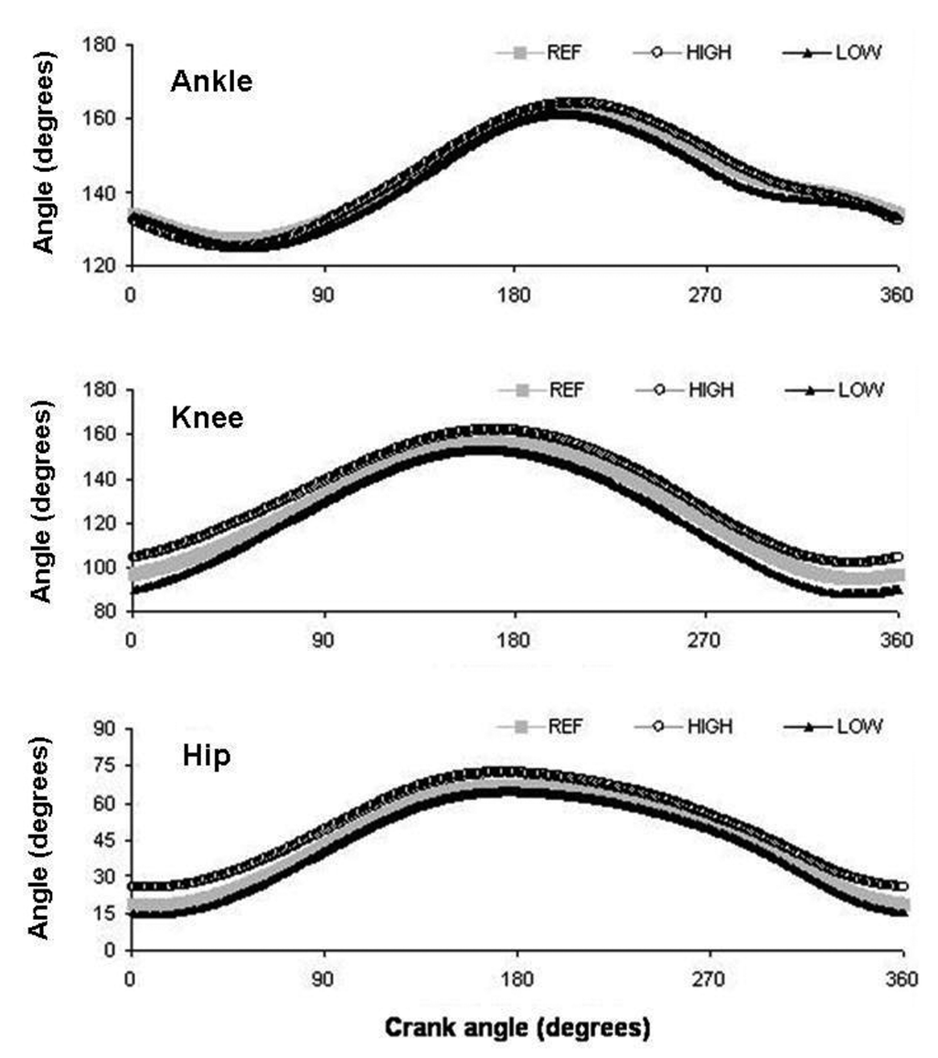
Review: Cycling Kinematics
Many cycling experiments have been performed across the country to answer research questions surrounding cycling kinematics, dynamics, and power output (Faulkner 2020, Leib 2008, Dembia 2017, Coleman 2007, Hull 1985, Gonzalez 1989, Fonda 2010)
Studies often use electromyography (EMG) and motion capture data to acquire muscle activation and joint angle data
Experimental data is crucial in verifying the fidelity of musculoskeletal modeling
Joint angles for ankle, knee, hip as a function of crank angle (Bini 2010)
Notes:
3- CEC
As a review, many cycling experiments have been done looking at cycling kinematics, dynamics, and power generation.
Experimental data, such as electromyography for muscle activation, and motion capture was collected to validate computational modeling.

Slide 9
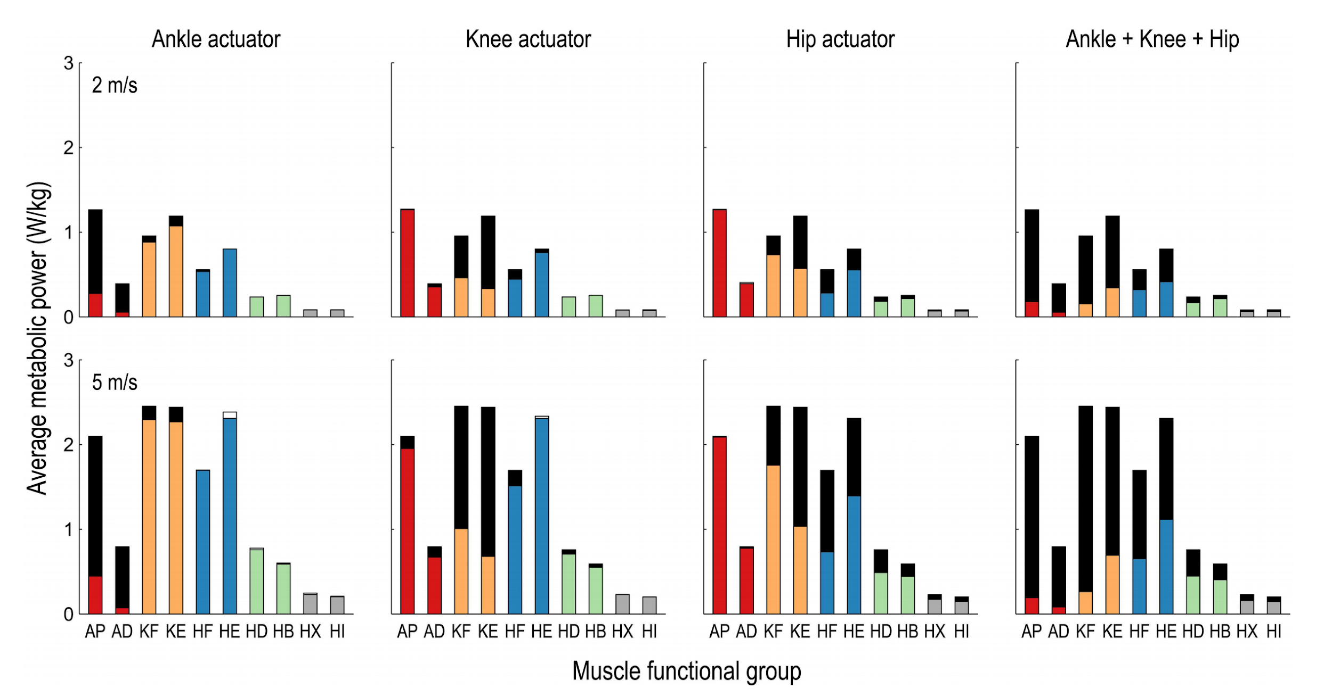
Review: History of OpenSim and Metabolics
OpenSim was released as an open-source science tool by Dr. Scott Delp and team at Stanford in 2007
Used extensively in biomechanics research & industry
OpenSim has been used to study metabolic efficiency of walking and running (Uchida 2016, Hamner 2013), making use of the Computed Muscle Control (CMC) tool
The CMC tool calculates synergistic muscle activations to produce a motion that best matches the imposed kinematics
Metabolic energy expenditure results are often validated with indirect calorimetry measurements (Uchida 2016, Hamner 2013)
Metabolic output normalized by body weight for running for each leg muscle (Uchida 2016)
Notes:
3- CEC
Another quick review is on OpenSim, a biomechanical computational tool that was developed by Scott Delp and his group at Stanford.
OpenSim has been used to study metabolics of other types of movement by making use of the Computed Muscle Control CMC tool which calculates synergistic muscle activations to produce kinematics with minimum deviations from a desired motion.
Metabolics can be validated with experimental measurements of gas exchange via indirect calorimetry.

Slide 10
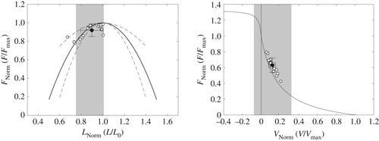
New: Biomechanical Analysis
Valuable insights can be gained from analysis of muscle states that are used to calculate muscle forces (OpenSim API 2015), and thus metabolic energy expenditure rate (Umberger 2013) during movement
Studies have been performed to show that muscles’ shortening velocity, force-length curve, and force-velocity curves have “important implications for...muscle efficiency” (Bohm 2019, Alcazar 2019)
We can use the muscle states data as a secondary measure to analyze how metabolic energy expenditure rates change as a function of seat position
Shaded regions indicate ranges of maximum force generation on the force-length curve (top) and force-velocity curve (bottom)
(Adapted from Bohm (2019))
Notes:
3- CEC
New background information that has and will become increasingly important as we move forward is centered on biomechanical analysis.
From OpenSim, we can extract muscle states, such as force-length and force-velocity relationships of muscle as seen in the figure on the right, which are used in calculating muscle forces and thus metabolic energy expenditure rates
There have been studies performed that have validated through modeling and experimental measurements that these muscle states have important implications for muscle efficiency
Thus, analysis of these muscles states can be used to analyze how metabolics change as a function of seat position
And now David will bring us through the refined workflow used for our complete analysis of one case

Slide 11
Workflow
Notes:
3’
DG

Slide 12
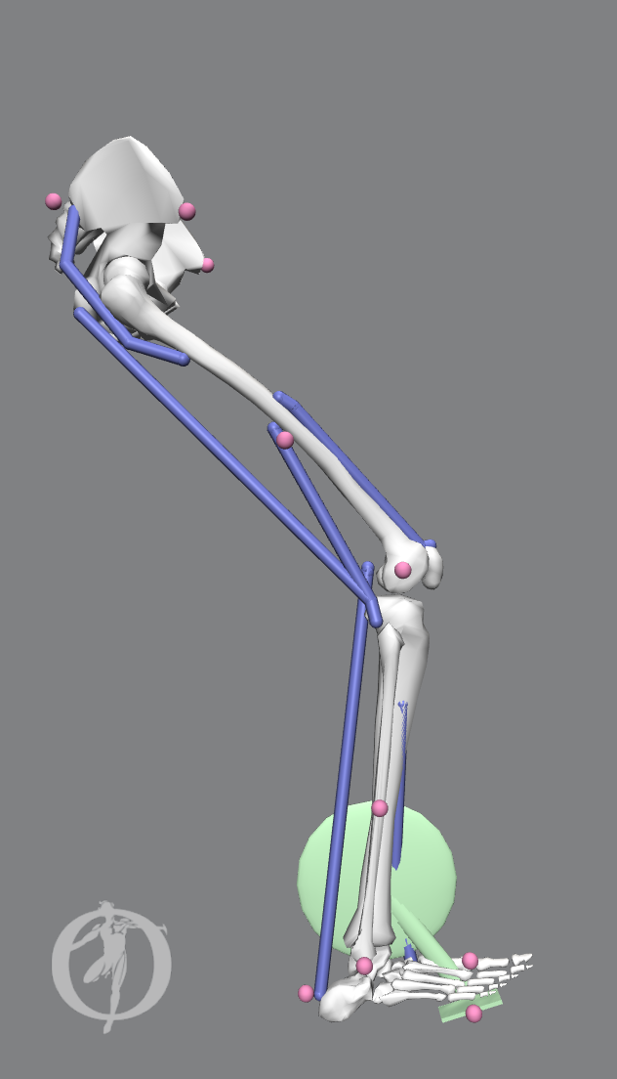
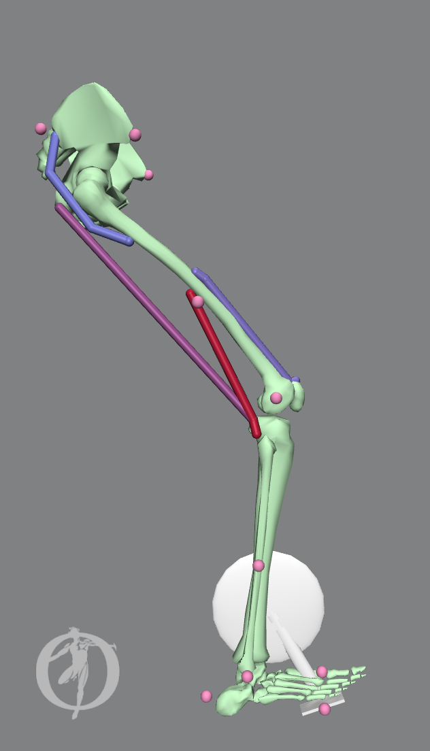
Workflow
Parameterized input: Saddle Position
(Passive) Simulated Forward Kinematics
(Active) Computed Muscle Control
Muscle Activations: [A₁]
Muscle Forces: [M₁]
Metabolic Energy Expenditure Rate:
[P₁]
Trial 1 (x₁ , y₁)
Trial 2 (x₂ , y₂)
...
Joint Angles: [Q₁]
Muscle Lengths: [L₁]
Muscle Velocities: [V₁]
External Forces: [F₁]
Trial n (x_{n} , y_{n})
+
Model constraints on coordinates
q_{i} ↔ q_{j} , i ≠ j
= driving the motion
Notes:
Figure 1: Iterative Mapping Process Workflow. Mapping from Seat Position to average Metabolic Energy Expenditure: T:Sx,yEmetabolic. A saddle position is chosen to collect data for, and a single value representative of metabolic energy expenditure is computed. Simulated Forward Kinematics takes the role of experimental motion capture data for the selected saddle position and is used to inform the Computed Muscle Control Tool. The Computed Muscle Control calculates a set of muscle activations and forces to reproduce the desired body kinematics of Simulated Forward Kinematics, and in turn metabolic energy expenditure of the muscles for the movement is calculated.
Parameters: GRFs, saddle height/position, kinematics, cadence,
The first step will always be making any necessary adjustments we need to make to the OpenSim model for the next iteration. It’s at this point where we choose a new saddle position for a example.
Then we generate a new set of joint angle trajectories and external force profiles using the adjusted model for our CMC Tool.
We then need to tailor the OpenSim specific files and scripts that the CMC Tool requires. The content of these files are directly influenced by every aspect of the OpenSim model, and so they must be updated for every physical change made to the model.
With all of the files needed for the CMC Tool organized, we can finally simulate a pedaling motion for the model and extract outputs of interest such as muscle excitation profiles and metabolic energy consumption probes.
Lastly, before beginning a new iteration cycle, it is important to compare the simulation outputs to our previous iterations to judge what qualitative improvements are being made.

Slide 13
Workflow
Parameterized input: Saddle Position
(Passive) Simulated Forward Kinematics
(Active) Computed Muscle Control
Muscle Activations: [A₁ , A₂]
Muscle Forces: [M₁ , M₂]
Metabolic Energy Expenditure Rate:
[P₁ , P₂]
Trial 1 (x₁ , y₁)
Trial 2 (x₂ , y₂)
Joint Angles: [Q₁ , Q₂ ]
Muscle Lengths: [L₁ , L₂]
Muscle Velocities: [V₁ , V₂]
External Forces: [F₁ , F₂]
+
Model constraints on coordinates
q_{i} ↔ q_{j} , i ≠ j
= driving the motion
Notes:
Figure 1: Iterative Mapping Process Workflow. Mapping from Seat Position to average Metabolic Energy Expenditure: T:Sx,yEmetabolic. A saddle position is chosen to collect data for, and a single value representative of metabolic energy expenditure is computed. Simulated Forward Kinematics takes the role of experimental motion capture data for the selected saddle position and is used to inform the Computed Muscle Control Tool. The Computed Muscle Control calculates a set of muscle activations and forces to reproduce the desired body kinematics of Simulated Forward Kinematics, and in turn metabolic energy expenditure of the muscles for the movement is calculated.
Parameters: GRFs, saddle height/position, kinematics, cadence,
The first step will always be making any necessary adjustments we need to make to the OpenSim model for the next iteration. It’s at this point where we choose a new saddle position for a example.
Then we generate a new set of joint angle trajectories and external force profiles using the adjusted model for our CMC Tool.
We then need to tailor the OpenSim specific files and scripts that the CMC Tool requires. The content of these files are directly influenced by every aspect of the OpenSim model, and so they must be updated for every physical change made to the model.
With all of the files needed for the CMC Tool organized, we can finally simulate a pedaling motion for the model and extract outputs of interest such as muscle excitation profiles and metabolic energy consumption probes.
Lastly, before beginning a new iteration cycle, it is important to compare the simulation outputs to our previous iterations to judge what qualitative improvements are being made.

Slide 14
Workflow
Parameterized input: Saddle Position
(Passive) Simulated Forward Kinematics
(Active) Computed Muscle Control
Muscle Activations: [A₁ , A₂ , … A_{n}]
Muscle Forces: [M₁ , M₂ , … M_{n}]
Metabolic Energy Expenditure Rate:
[P₁ , P₂ , … P_{n}]
Trial 1 (x₁ , y₁)
Trial 2 (x₂ , y₂)
...
Joint Angles: [Q₁ , Q₂ , … Q_{n}]
Muscle Lengths: [L₁ , L₂ , … L_{n}]
Muscle Velocities: [V₁ , V₂ , … V_{n}]
External Forces: [F₁ , F₂ , … F_{n}]
Trial n (x_{n} , y_{n})
+
Model constraints on coordinates
q_{i} ↔ q_{j} , i ≠ j
n = trial number
= driving the motion
Notes:
Figure 1: Iterative Mapping Process Workflow. Mapping from Seat Position to average Metabolic Energy Expenditure: T:Sx,yEmetabolic. A saddle position is chosen to collect data for, and a single value representative of metabolic energy expenditure is computed. Simulated Forward Kinematics takes the role of experimental motion capture data for the selected saddle position and is used to inform the Computed Muscle Control Tool. The Computed Muscle Control calculates a set of muscle activations and forces to reproduce the desired body kinematics of Simulated Forward Kinematics, and in turn metabolic energy expenditure of the muscles for the movement is calculated.
Parameters: GRFs, saddle height/position, kinematics, cadence,
The first step will always be making any necessary adjustments we need to make to the OpenSim model for the next iteration. It’s at this point where we choose a new saddle position for a example.
Then we generate a new set of joint angle trajectories and external force profiles using the adjusted model for our CMC Tool.
We then need to tailor the OpenSim specific files and scripts that the CMC Tool requires. The content of these files are directly influenced by every aspect of the OpenSim model, and so they must be updated for every physical change made to the model.
With all of the files needed for the CMC Tool organized, we can finally simulate a pedaling motion for the model and extract outputs of interest such as muscle excitation profiles and metabolic energy consumption probes.
Lastly, before beginning a new iteration cycle, it is important to compare the simulation outputs to our previous iterations to judge what qualitative improvements are being made.

Slide 15
Workflow
Parameterized input: Saddle Position
(Passive) Simulated Forward Kinematics
(Active) Computed Muscle Control
Muscle Activations: [A₁ , A₂ , … A_{n}]
Muscle Forces: [M₁ , M₂ , … M_{n}]
Metabolic Energy Expenditure Rate:
[P₁ , P₂ , … P_{n}]
Trial 1 (x₁ , y₁)
Trial 2 (x₂ , y₂)
...
Joint Angles: [Q₁ , Q₂ , … Q_{n}]
Muscle Lengths: [L₁ , L₂ , … L_{n}]
Muscle Velocities: [V₁ , V₂ , … V_{n}]
External Forces: [F₁ , F₂ , … F_{n}]
Trial n (x_{n} , y_{n})
+
Model constraints on coordinates
q_{i} ↔ q_{j} , i ≠ j
n = trial number
= driving the motion
Notes:
Figure 1: Iterative Mapping Process Workflow. Mapping from Seat Position to average Metabolic Energy Expenditure: T:Sx,yEmetabolic. A saddle position is chosen to collect data for, and a single value representative of metabolic energy expenditure is computed. Simulated Forward Kinematics takes the role of experimental motion capture data for the selected saddle position and is used to inform the Computed Muscle Control Tool. The Computed Muscle Control calculates a set of muscle activations and forces to reproduce the desired body kinematics of Simulated Forward Kinematics, and in turn metabolic energy expenditure of the muscles for the movement is calculated.
Parameters: GRFs, saddle height/position, kinematics, cadence,
The first step will always be making any necessary adjustments we need to make to the OpenSim model for the next iteration. It’s at this point where we choose a new saddle position for a example.
Then we generate a new set of joint angle trajectories and external force profiles using the adjusted model for our CMC Tool.
We then need to tailor the OpenSim specific files and scripts that the CMC Tool requires. The content of these files are directly influenced by every aspect of the OpenSim model, and so they must be updated for every physical change made to the model.
With all of the files needed for the CMC Tool organized, we can finally simulate a pedaling motion for the model and extract outputs of interest such as muscle excitation profiles and metabolic energy consumption probes.
Lastly, before beginning a new iteration cycle, it is important to compare the simulation outputs to our previous iterations to judge what qualitative improvements are being made.

Slide 16
Complete Analysis
for One Case
Notes:
3-5’ - CC
Now, using our workflow, we’ll take you through a complete analysis for 1 case

Slide 17
Workflow: Adjust OpenSim Model Input
Step
1
Generate each set of saddle positions to run trials:
Pick center position (X’, Y’) for pelvis
Define the range for X and Y directions by picking some distance, D
Pick a step size for each direction, δl, δh
Increment by ±δl, ±δh for entire range of X and Y
Combine all (X, Y) to form a set of trials that explore a search space centered at (X’, Y’)
Saddle position, S_{X,Y}
Notes:
1.5’ CC
To start off our workflow, we need to define and generate a set of saddle positions to begin running trials on.
The way we do this is to start with some center position (X’, Y’) which corresponds to the location of the center of mass of the pelvis.
Then we define the range for the x and y directions by picking some distance, D
Then we pick a step size for each direction x, and y, meaning some dl and dh, before we apply those step sizes to the entire range of X and Y to get a set of combinations that explore a search space centered at x’ y’
https://simtk-confluence.stanford.edu/display/OpenSim/OpenSim+Teaching+Materials+--+Educational+Cycling+Model
Included muscles are 1 quadriceps head (vastus intermedius), hamstrings (biceps femoris long and short heads), and gluteus maximus.
Constr
4 upper leg muscles, pelvis constrained to saddle, metatarsal constrained to pedal
1 muscle excitation forward dynamics External forces generated from forward dynamics constraints

Slide 18
Workflow: Adjust OpenSim Model Input
Step
1
Generate each set of saddle positions to run trials:
Pick center position (X’, Y’) for pelvis:
(X’ = -0.226m, Y’ = 0.8m)
Define the range for X and Y directions by picking some distance: D = 0.01m
Pick a step size for each direction: δl = 0.01m, δh = 0.01m
Increment by ±0.01m, ±0.01m for entire range of X and Y
→ Unique saddle positions:
( X , Y ), (-0.236, 0.8), (-0.236, 0.81)
(-0.226, 0.79), (-0.226, 0.8), (-0.226, 0.81)
(-0.216, 0.79), (-0.216, 0.8), (-0.216, 0.81)
Saddle position, S_{X,Y}
Notes:
1.5’ CC
-0.126 0.84999999999999998 -0.12 - offset of pelvis to ground
In terms of our first case, we picked our x’ y’ to be -0.226 m and 0.8 m respectively from the bottom bracket
Our distance in each direction was 0.01 m and our steps to cover length and heights were also 0.01 m. With these combinations, we were able to generate our first set of unique saddle positions as you see here.
https://simtk-confluence.stanford.edu/display/OpenSim/OpenSim+Teaching+Materials+--+Educational+Cycling+Model
Included muscles are 1 quadriceps head (vastus intermedius), hamstrings (biceps femoris long and short heads), and gluteus maximus.
Constr
4 upper leg muscles, pelvis constrained to saddle, metatarsal constrained to pedal
1 muscle excitation forward dynamics External forces generated from forward dynamics constraints

Slide 19

Workflow: Simulate Forward Kinematics
Step
2
Prescribe a constant pedaling speed
Model passively follows crank via constraints:
Midfoot and pedal
Fixed pelvis
DOF range of motion limits
Joint angles (Q), muscle lengths (L), muscle velocities (V), and reaction forces at the midfoot-pedal constraint (F) are extracted
Notes:
1.5’ SR
“This step is not unlike conducting a motion capture experiment in a human performance lab to record joint angles”

Slide 20

Workflow: Adjust OpenSim CMC Tool
Objective Function, J
Step
3a
A control law tracks deviations between the coordinates (DOF) of the desired motion and the coordinates (DOF) of the motion from muscle activations calculated by the CMC Tool solver
The optimization solver iterates until a solution of muscle activations is found that minimizes the objective function J, where J is the sum of muscle activations and weighted deviations of the muscle-driven DOF from the desired kinematics DOF.
Objective Function for Muscle Activations, J
q"_{j}* = | desired (input) accelerations for the j-th coordinate [rad/s²]
q"_{j} = | model accelerations for the j-th coordinate [rad/s²]
w_{j} = | coordinate weights [s²/rad]
x_{i} = | muscle activations / actuator controls for the i-th actuator [dimensionless]
Notes:
DG 2’
CMC is a type of inverse dynamics solver that returns a vector of muscle activations for the model for some desired motion. How does it choose it’s specific solution when a system with several degrees of freedom can yield several solutions from inverse dynamics?
Control law…
Objective function…
CEC Additional Constraints File (optional)
each of the files is specific and must be tailored to accommodate each model’s kinematics and anthropometric measurements
files must be specific for each model’s kinematics because the human body is highly variable
Muscle (length, velocity, activation)
High flexion/low flexion conditions
Realistic dynamics is optimization problem of different combo of muscles activations and timings
Multi scale model (muscles; bones; over large joint angles)
we have established a set of overall files --> expect and anticipate minor modifications needed in between kinematic sets
TT weights actuation constraints
Confirmed with opensim expert as best version of streamlined process

Slide 21
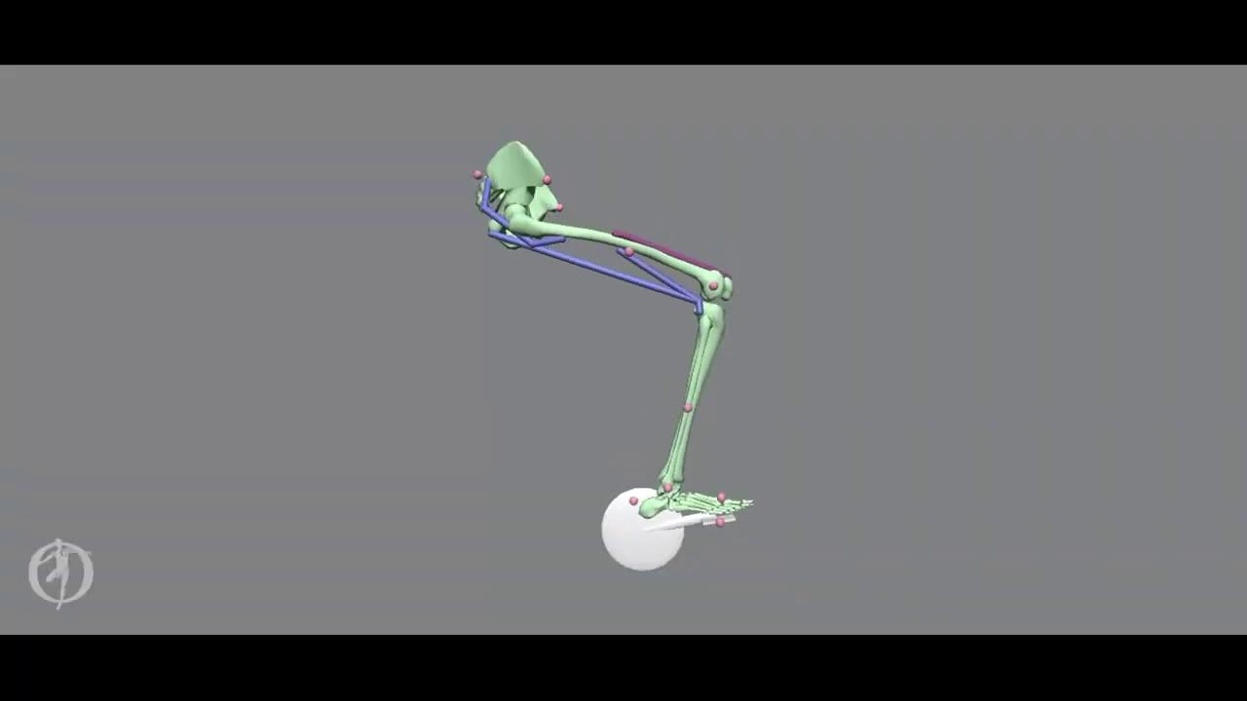
Workflow: Run CMC Tool w/ Metabolic Probes
Step
3b
Tuning CMC Objective Function
Select subset of DOF to track for desired kinematics
Choose weighting of DOF
Outputs
Muscle activations calculated
Kinematics produced to minimize deviation from desired motion (motion from Simulated Forward Kinematics)
Metabolic Energy Expenditure Rate
Notes:
CEC 1.5’
The objective function that David just talked about is fine-tuned based on the DOF we specify the solver to track and the weighting of the importance of these tracked DOF. This fine-tuning is performed in order to set up the CMC Tool to be able to solve for a solution.
Once the CMC Tool is run, we extract outputs of:
Muscle activations vs time
Kinematics which are produced by these muscle activations with the objective of minimizing deviations from the motion from the Simulated Forward Kinematics run in Step 2
And, finally, the metabolic energy expenditure rates over the cycling cycle

Slide 22
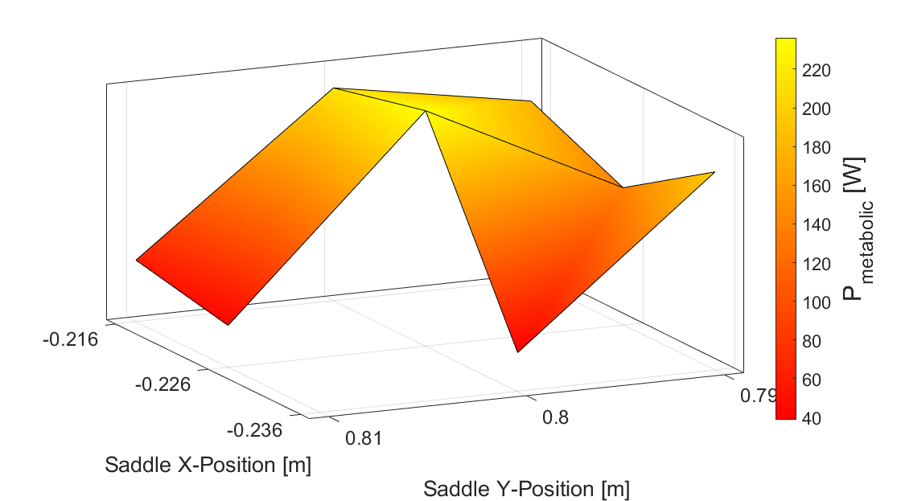
Workflow: Compile Results
Step
4
First attempt at 3D mapping of saddle position →
metabolic energy expenditure rate for all trials
Analysis in following slides
Notes:
CEC .5’
Once we’ve run a full set of saddle positions through Simulated Forward Kinematics and CMC, we perform a mapping of the total metabolic expenditure rate of all of the muscles vs seat position
Shown is our first attempt at this 3D mapping for a set of all of our trials
This mapping is not exactly what we had anticipated
Analysis of this mapping will be presented in the following slides and a path forward

Slide 23
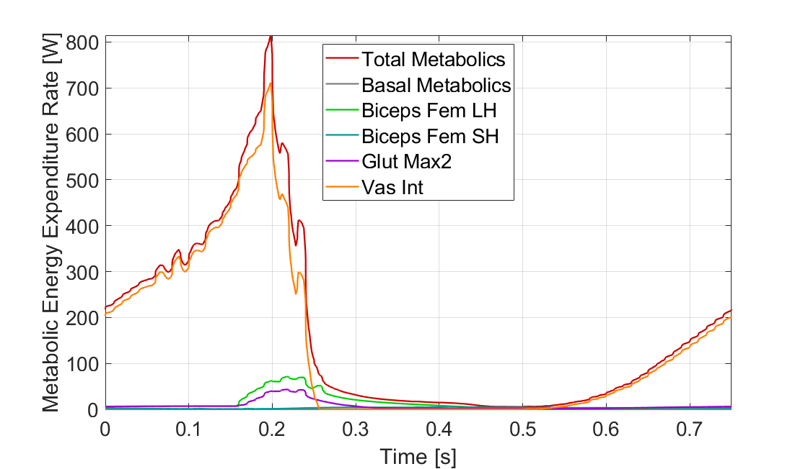
Comparison Across Muscles
Smoothed Data from Trial: X=-0.216m Y=0.80m
Vastus intermedius contributes the most to the total metabolic energy expenditure rate
Notes:
DG 1.5’
With the current motion of our model, starting at the top of the pedaling motion, we see that a majority of the energy expended by the model is used to activate the quadricep vastus intermedius.
While we can visually track activations during the simulation based on the red coloring of muscles, the metabolic energy expenditure rates that we extract from the computed muscle control simulation is quantifying where the model is expending energy since activation is not the sole determining factor for energy expenditure.
We observed the vastus intermedius dominating the energy expenditure across all trials so with our current trials and data, this is our muscle of interest.

Slide 24
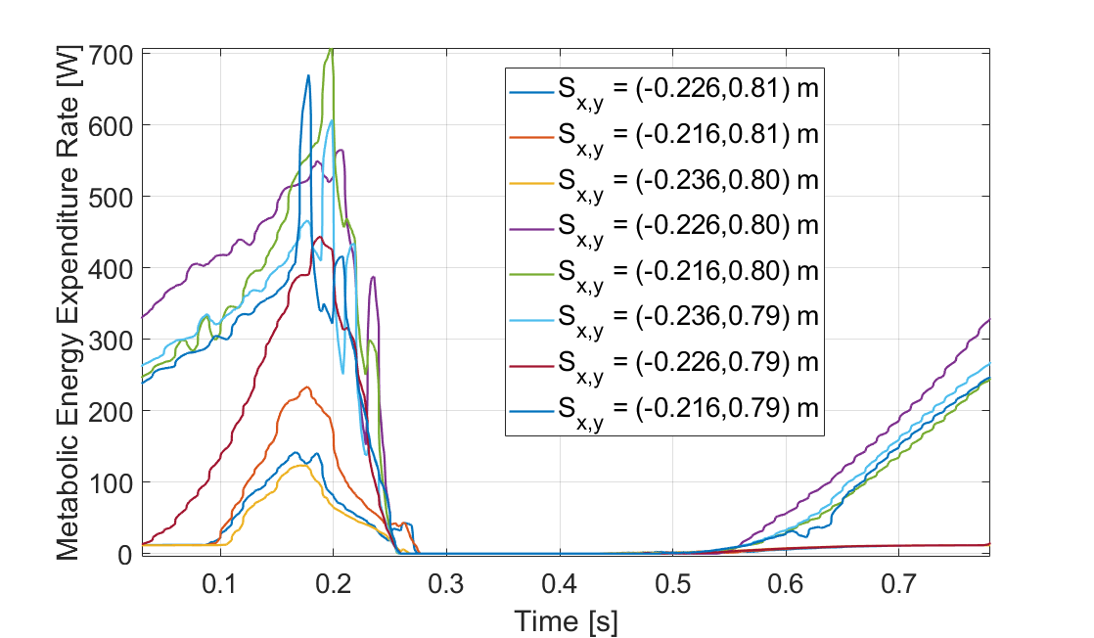
Comparison Across Trials
Metabolic energy expenditure rate varies widely, due to forced iterations in optimization solver and CMC constraint files
Vastus intermedius metabolic energy expenditure rate peaks as down stroke portion of cycling gait is completed for all trials
Smoothed Data from all trials
Notes:
DG
Here we have the metabolic energy expenditure rates of the vastus intermedius across all 8 of our trials. However, any trends between saddle position and metabolic energy expenditure are very difficult to parse out from this data. In fact, the biggest differences between the data occur when we needed to tweak the model constraints to allow for CMC to find a solution. When the orientation of the pelvis was constrained, we observed the peak rate of energy expenditure sits at around 100 - 200 Watts, and when the orientation of the pelvis was relaxed, the peak rate of energy expended jumps to a range of 400 to 700 Watts.
Gradient optimization problem is happening during the solve meaning there is an element of stochasticity in the search space (or at least in the starting point of the search space). Results are therefore not 100% reproducible and repeatable.

Slide 25
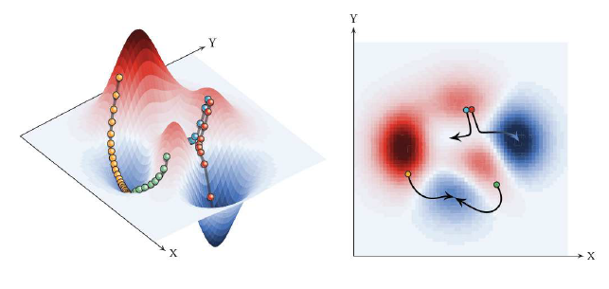
Optimization Pitfalls: Local Minima
Gradient descent optimization requires stochastic initialization of starting position, leading to convergence towards local minima at times (Uchida, Delp 2020)
Notes:
CC 1’
We realize our initial data is less informative than it could be. A lot of the variation between trials can be explained by the CMC settings that required changes in between runs in order for the OpenSim CMC Tool to find any solution. These settings sometimes required quite a bit of change between trials due to the large number of constraints on the movement allowed by the model. This led to pitfalls in the static optimization step of the solver where it carries out gradient descent optimization. These kinds of optimizations require stochastic initialization of the start position for potential solutions. That Initial guess is effectively random which means we may not always converge at the same global minimum for the objective function of muscle activations and desired kinematics but instead may converge towards other local minimum. This means, each trial potentially found different local minima to converge at and we cannot assume they converged at the global minimum, which may be more comparable across trials.
In Machine learning, the classic way to avoid local minima is to use randomization, but there is no way to guarantee that every time we would get the global minimum. Some things we are looking into is adjusting the CMC tool optimization convergence tolerance and integrator and derivative stepping sizes.
Our 1-legged cycling model is frankly a use case that CMC was never truly scoped out for. There are a significant number of constraints on the movement allowed by the model and less available musculature than would be normally included (idk if more muscles is good in general tho). CMC was initially intended and developed with motions such as walking gait analysis in mind, which is significantly less constrained (probably can’t say this without a citation) and are cases where a reproducible solution is generally more feasible with the aforementioned optimization.
This effectively means that our CMC trials are not 100% reproducible or repeatable which may pose significant challenges as we continue exploring this path.

Slide 26
Discussion: Ideas to Explore
Notes:
5-6’ - SR

Slide 27
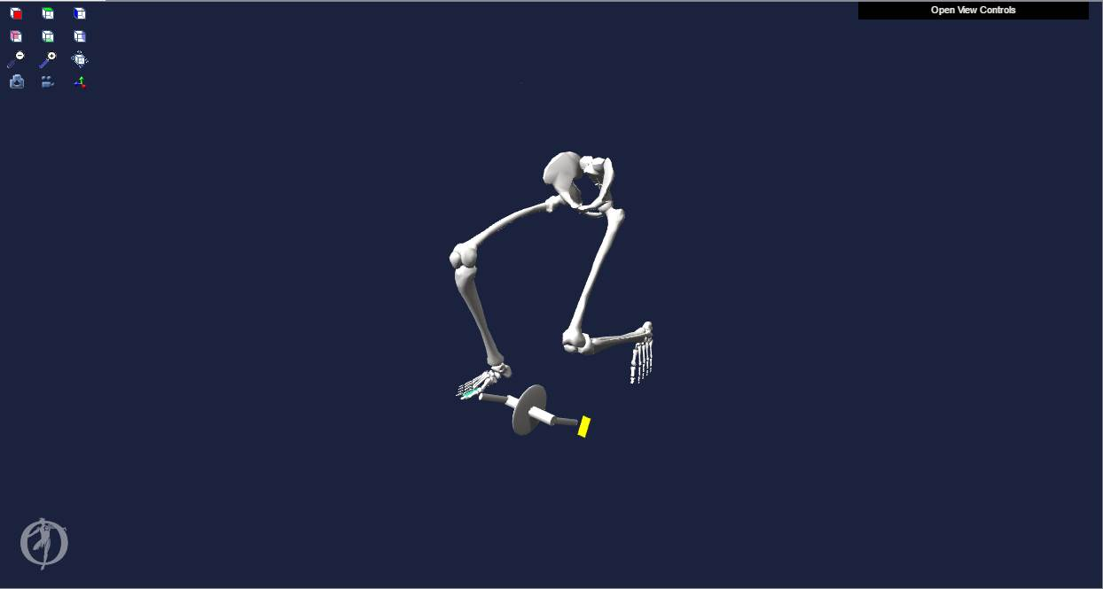
Two-Leg Model
Benefits
Possibility of more accurately demonstrating coupled motion between the two legs
Specialized can transfer motion-capture data from experimental trials directly into OpenSim
Drawbacks
Depends heavily on constraints and coupled motion of the two legs
The Computed Muscle Control Tool is sensitive to the number of DOF in the model (often fails to find a solution)
Initial barebones two-leg model attempt (unconstrained left leg)
Notes:
5-6’ - SR

Slide 28
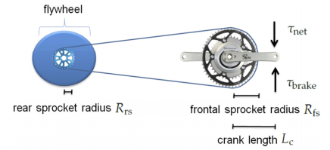
Resistance Torque
Benefits
Increases the complexity of our model with more realistic pedaling forces
Allows Specialized to also parametrize pedal forces as an input to account for terrain and internal bike friction
Drawbacks
To achieve robust analysis, the input torque profile must be model-specific
Schematic of brake/resistive torque in relation to crank and sprocket dimensions (Quintana-Duque 2015)
Notes:
5-6’ - SR
cyclists change gears along the duration of their ride
From our literature review, we have even identified common resistive torque profiles

Slide 29
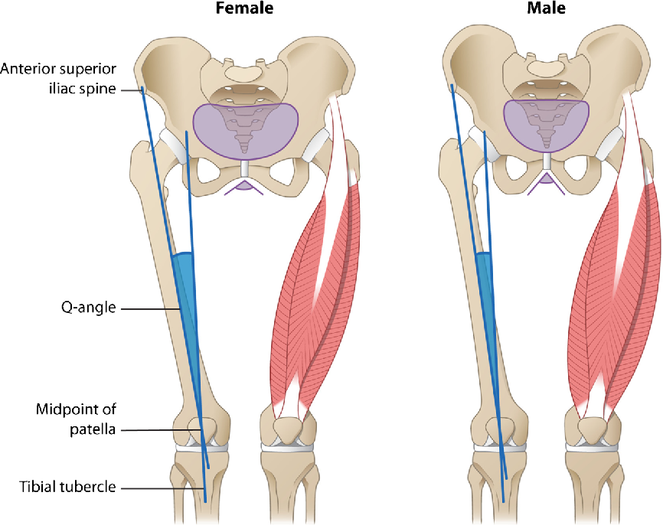
Male vs. Female Cyclists
Benefits
Specialized can run experimental trials for a wider demographic
Muscle properties and joint angle relationships can be customized in OpenSim
Drawbacks
Minimal literature on female cycling biomechanics
Q-angle
Depicting biomechanical (Q-angle) differences widespread between males and females (Pappas 2019)
Notes:
5-6’ - SR
highlight the impact of the biomechanical differences inherent between male and female cyclists on metabolic expenditure rate
Women also tend to injure their ACLs more often than men, could potentially optimize saddle height in order to minimize risk of injury as well

Slide 30
Implications of Fatigue (Sprint & Endurance)
Benefits
Allows Specialized to improve cycling performance for sprinters or endurance riders with analysis of muscle fatigue
Helps cyclists understand how to manage muscle recovery from strenuous activation
Opportunity to validate OpenSim fatigue results using electromyography (EMG)
Drawbacks
Uncertainty of OpenSim to run long-term analysis (several hours)
Difficult to evaluate “fatigue”
Notes:
5-6’ - SR
implications of fatigue on metabolic expenditure rate

Slide 31
Honorable Mentions
Validating Ground Reaction Forces with Experimental Data
Different Cycling Gaits
Applying Aerodynamic Drag Forces
Modeling Handlebars and Vary Locations
Notes:
5-6’ - SR

Slide 32
Plan: Next 3 Weeks
Notes:
3-5’ - CC
Finally, we’ll over our plan for the next 3 weeks

Slide 33
Plan: Next 3 Weeks
Explore larger ranges of saddle positions based on literature
Analyze muscle states output (muscle lengths, muscle velocities) from simulated forward kinematics
Avoids using the CMC Tool
Add complexity to the OpenSim model
Adding muscles for the lower leg
Adding a second leg
Notes:
In the next 3 weeks, we have 3 main focuses. The first is the explore larger ranges of saddle position using literature to inform and narrow our search
The next is the analyze muscle states, which are our intermediary outputs in our workflow, and how they can be used to inform energy expenditure rates without the use of the CMC Tool.
And Finally, we are looking to add complexity to the OpenSim model by adding additiona muscles and potentially a second leg.

Slide 34
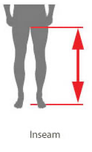
Plan: Exploring More Saddle Positions
Literature estimates of optimal saddle height:
109% of inseam length (Peveler 2011)
100% of trochanteric length (Price 1997)
96% of the sum of shank and thigh length (Mellion 1991)
Using OpenSim Model geometries, physical lengths can be measured and computed to provide a more informed starting position from which to build a set of positions for trials
Notes:
To explain the first goal, we are looking to use literature to focus our search space for potentially optimal saddle positions. A variety of sources over the years have studied measures of optimal saddle height. The measures can come from inseam length, trochanteric length (which is the distance between your trochanter protrusion on your upper leg to the floor), and sum of shank and thigh length just to name a few.
Using OpenSim Model Geometries, these anatomical lengths can be measured and computed to provide a more informed starting position from which to build our set of positions for future trials. This means, we can go into the files for the cycling model we have, look up these lengths or measure them through OpenSim, apply the 109% or 96% or other adjustment determined by prior literature to obtain a height for the saddle position that could be ideal. This is also a great way for us to validate our model and its results against literature.

Slide 35
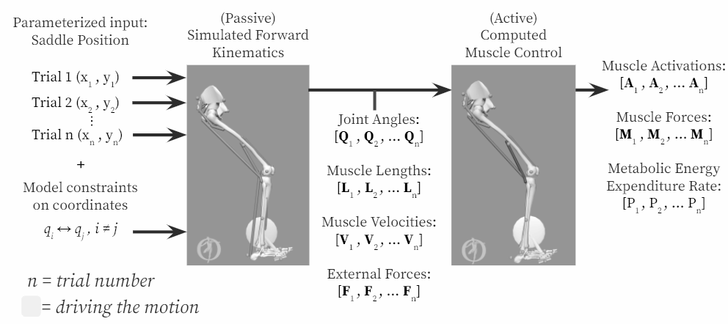
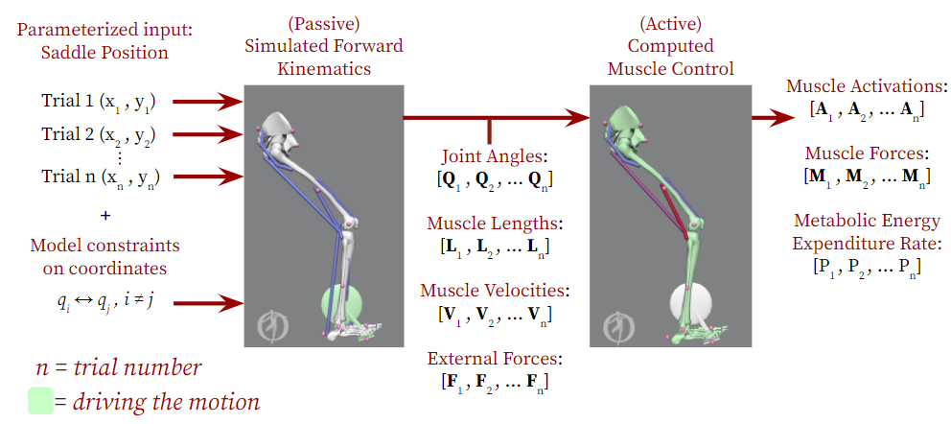
Plan: Using Muscle States Outputs
Use muscle states outputs to find regions of maximum and minimum muscle fiber force generation
(Adapted from Bohm (2019))
Notes:
CEC
As we talked about earlier in the related work, we can use muscle states outputs to find regions of maximum and minimum muscle fiber force generation.
As a reminder, the muscle states come out of the Simulated Forward Kinematics step in our workflow and can be post-processed to show these regions of maximum muscle fiber force generation as seen in literature.
These shaded regions indicate regions of minimized metabolic energy expenditure rates because the muscles are stronger at these times and do not need to work as hard to produce forces sufficient for movement.

Slide 36
Plan: Adding Complexity Through Muscles
Gastrocnemius added
Gastrocnemius & Tibialis Anterior added
Notes:
CC
To speak to the final point, we plan to add complexity to our model through additional muscles and here you can see, we’ve made progress on this through adding the gastrocnemius on the lefthand side and adding the gastroc and tibialis anterior on the righthand side.

Slide 37
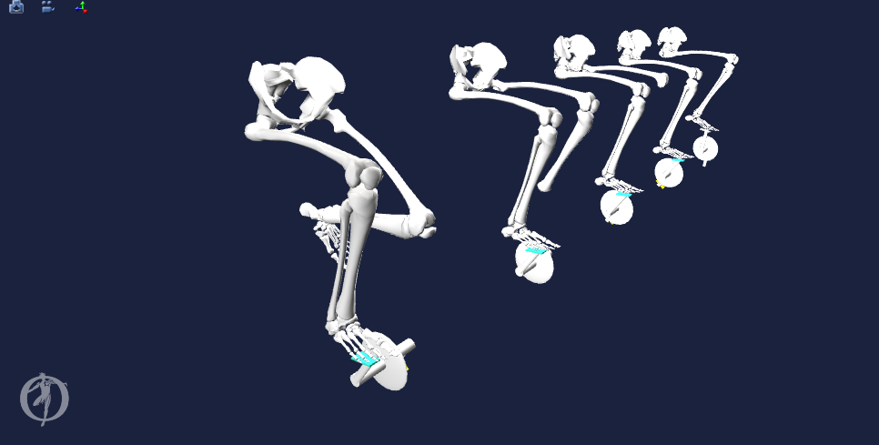

Plan: Adding Complexity with 2-Leg Model
2-Leg Model Creation Evolution
Notes:
CEC
In the works is the development of a 2-leg model (bare-bones status of model is shown)
Geom less the muscles and constraints
We hope that this model can achieve its potential of more accurately demonstrating coupled motion between the two legs
However, we do anticipate some potential slow-downs as the model depends heavily on constraints and coupled motion of the two legs
As well as the CMC tool is sensitive to the number of DOF and constraints in a model and often fails to find a solution
Nonetheless, we can perform biomechanical analysis on a completed 2-leg model with Simulated Forward Kinematics which does not require a CMC run

Slide 38
Timeline
→ Currently in progress
Week 2 | Week 3 | Week 4 | Week 5 | Week 6 | Week 7 | Week 8 | Week 9 | Week 10
1/18 | 1/25 | 2/1 | 2/8 | 2/15 | 2/22 | 3/1 | 3/8 | 3/15
OpenSim learning |  |  | Define workflow | Parameterize saddle position
Literature research |  |  |  | Develop higher complexity models (2-leg, additional muscles)
Workflow development |  |  | Ensure GRF at pedals is reasonable |  |  | Collect data on parameterizations
Meet with OpenSim experts & document research and process thoroughly
 | Compute muscle forces & metabolic output through CMC; Biomechanical analysis of muscle states
Notes:
CEC
Overall, to wrap it up, here is our timeline for the next few weeks as we approach the finish line at week 10.
The blocks in green are currently being worked on and we intend to also use the couple weeks at the end for final wrap up activities and documentation for hand-off to Specialized.

Slide 39
References
Wozniak Timmer, Cheryl A., MS, PT. (1991). Cycling Biomechanics: A Literature Review. Journal of Orthopaedic & Sports Physical Therapy. 14:3. 106-113.
Tsianos, George A, and Lisa N MacFadden. Validated Predictions of Metabolic Energy Consumption for Submaximal Effort Movement. PLoS computational biology vol. 12,6 e1004911. 1 Jun. 2016
Bini, Rodrigo & Hume, Patria & Croft, James. (2011). Effects of Bicycle Saddle Height on Knee Injury Risk and Cycling Performance. Sports medicine (Auckland, N.Z.). 41. 463-76.
Faulkner, S. and Jobling, P. The Effect of Upper-Body Positioning on the Aerodynamic-Physiological Economy of Time-Trial Cycling. International Journal of Sports Physiology and Performance, (2020).
Uchida TK, Seth A, Pouya S, Dembia CL, Hicks JL, Delp SL (2016) Simulating Ideal Assistive Devices to Reduce the Metabolic Cost of Running. PLoS ONE 11
Fonda, B., & Sarabon, N. (2010). Biomechanics of cycling ( Literature review ). Sport Science Review, 19(1), 187–210
Bini RR, Tamborindeguy AC, Mota CB. Effects of saddle height, pedaling cadence, and workload on joint kinetics and kinematics during cycling. J Sport Rehabil. 2010
OpenSim::Umberger2010MuscleMetabolicsProbe Class Reference. OpenSim API 3.3 Documentation (2015).
Brian R. Umberger, Karin G.M. Gerritsen & Philip E. Martin (2003) A Model Of Human Muscle Energy Expenditure, Computer Methods In Biomechanics And Biomedical Engineering,
Bohm Sebastian, Mersmann Falk, Santuz Alessandro, and Arampatzis Adamantios (2019) The force–length–velocity potential of the human soleus muscle is related to the energetic cost of running Proc. R. Soc. B.286
Alcazar J, Csapo R, Ara I and Alegre LM (2019) On the Shape of the Force-Velocity Relationship in Skeletal Muscles: The Linear, the Hyperbolic, and the Double-Hyperbolic.
Hamner, Samuel R, Delp, Scott L. Muscle contributions to fore-aft and vertical body mass center accelerations over a range of running speeds, Journal of Biomechanics, Volume 46, Issue 4, 2013
Quintana-Duque, J.C., Dahmen, T., Saupe, D., 2015. Estimation of torque variation from pedal motion in cycling. Int. J. Comput. Sci. Sport 14, 34–50.
Pappas, E (2019) Do Female Athletes get ACL injuries because of their ANATOMY?
Price D, Donne B. (1997) Effect of variation in seat tube angle at different seat heights on submaximal cycling performance in man
Mellion MB. (1991) Common cycling injuries: management and prevention
Dembia CL, Silder A, Uchida TK, Hicks JL, Delp SL Simulating ideal assistive devices to reduce the metabolic cost of walking with heavy loads. PLOS ONE 12(7): e0180320, (2017).
Leib, D. The Effects of Clear Placement on Muscle Mechanics and Metabolic Efficiency in Prolonged Sub-Maximal Cycling. Ball State University Biomechanics Laboratory Thesis, (2008).
Thomas K. Uchida and Scott L. Delp (2020) Biomechanics of Movement: The Science of Sports, Robotics, and Rehabilitation
Coleman DA, Wiles JD, Davison RC, Smith MF, Swaine IL. Power output measurement during treadmill cycling. Int J Sports Med. ;28(6):525-30, (2007).
Peveler, W. and Green, J. Effects Of Saddle Height On Economy And Anaerobic Power In Well-trained Cyclists. National Strength and Conditioning Association , Vol 25, 3, (2011).
Hull, M.L. and Jorge, M. A Method For Biomechanical Analysis of Bicycle Pedalling. Journal of Biomechanics Vol 18 No 9. pp 631-644, (1985).
Gonzalez, H. and Hull, M.L. Multivariable Optimization of Cycling Biomechanics. Journal of Biomechanics Vol. 22 No 11/12 pp 1151-1161, (1989).

Slide 40
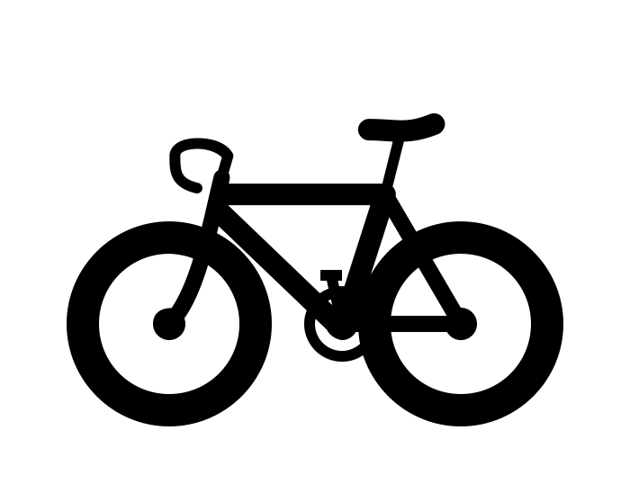
Thank you
Justin Tucker, Specialized mentor
Ross Wilkinson, CU Boulder Researcher
Carmichael Ong, OpenSim expert/mentor
Adrian Lew, Professor/mentor
Amir Nasrollahi, TA/mentor
Notes:
CEC

Slide 41
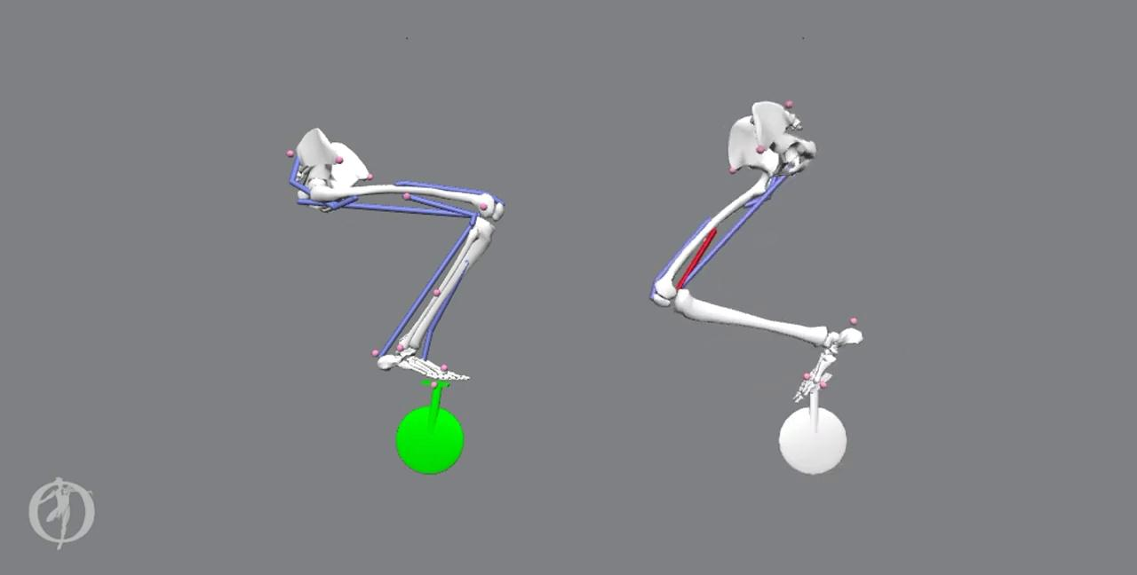



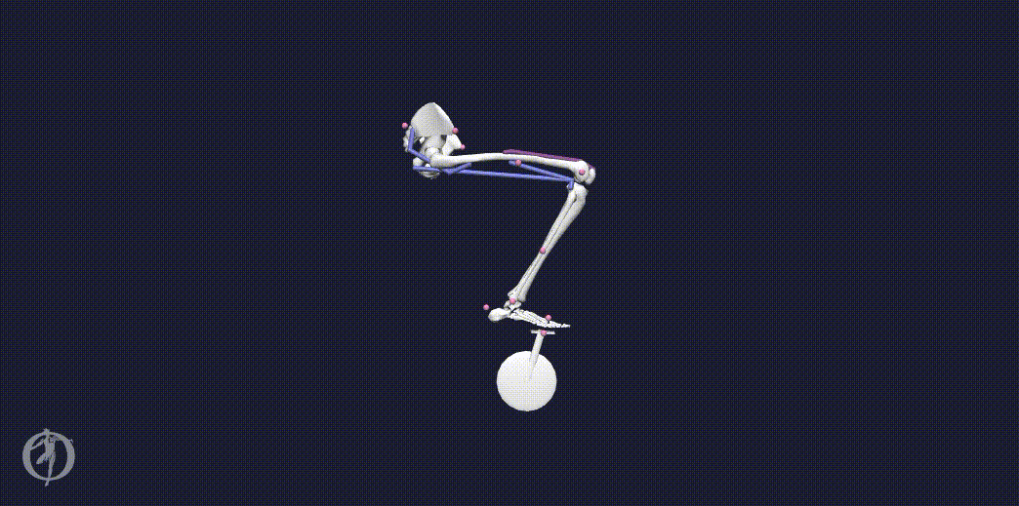

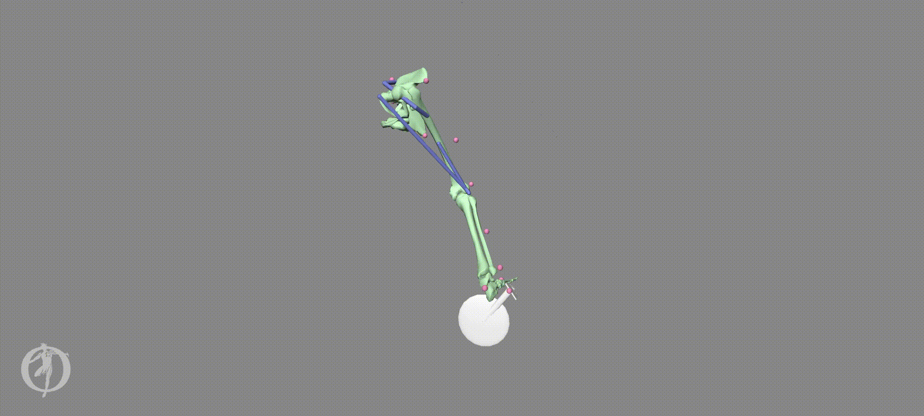
Thank you
Thank you
INSERT BLOOPER GIFS
Notes:
CEC

Slide 42
Appendices

Slide 43
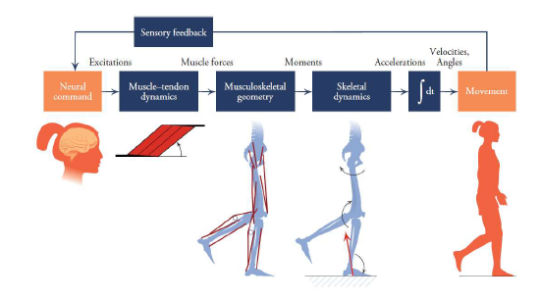
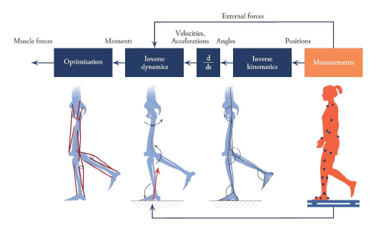
Forward Dynamics (L) vs. Inverse Dynamics (R)
Source: Figure 1.12 and Figure 1.13 Biomechanics of Movement: The Science of Sports, Robotics, and Rehabilitation by Thomas K. Uchida and Scott L. Delp (2020)

Slide 44
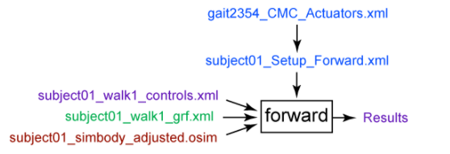
OpenSim Crash Course
Forward Dynamics
The Forward Dynamics Tool is used to calculate joint kinematics based on assumed muscle activations.
Simplest tool
Downside: Muscle activations assumed.
https://simtk-confluence.stanford.edu/display/OpenSim/Getting+Started+with+Forward+Dynamics
Inputs: Muscle excitation w.r.t. time, constraints on bodies’ coordinates (e.g. pelvis xyz-position, foot-on-pedal)
Outputs: Can obtain a wide array of outputs while muscle activation drives the simulation. Most useful will typically be joint angles, muscle-fiber lengths, and other body kinematics.
Notes:
The purpose of inverse kinematics (IK) is to estimate joint angles from experimental data. The purpose of inverse dynamics (ID) is to estimate forces & moments.
CMC is likely our primary tool for obtaining the relevant muscle forces with a well defined trajectory (joint angles) and external loads (pedal reaction forces)

Slide 45
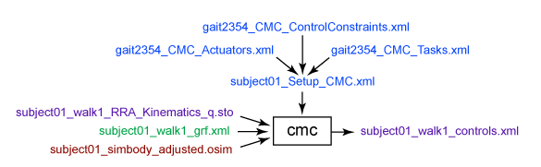
OpenSim Crash Course
CMC Tool (Computed Muscle Control)
The CMC tool is used to calculate muscle excitations based on desired kinematic inputs under various constraints/ boundary conditions.
Difficult to obtain convergence/ optimization
https://simtk-confluence.stanford.edu/display/OpenSim/Getting+Started+with+CMC
Inputs: Kinematics (joint angles, translations), coordinate tracking requests, constraints, actuation, GRFs
Outputs: Muscle activation forces, muscle activations/controls, muscle states of motion (joint angles & velocities; muscle fiber lengths & activations)
Ability to request Metabolic Probes
CMC Tool incorporate principles from Inverse Kinematics (IK) & Inverse Dynamics (ID) workflows
Notes:
The purpose of inverse kinematics (IK) is to estimate joint angles from experimental data. The purpose of inverse dynamics (ID) is to estimate forces & moments.
CMC is likely our primary tool for obtaining the relevant muscle forces with a well defined trajectory (joint angles) and external loads (pedal reaction forces)

Slide 46
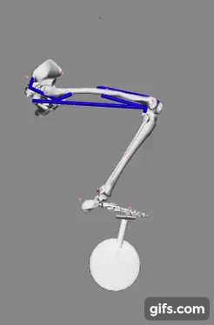
Review: Past Stanford Project Cycling Model
Existing one-legged OpenSim cycling model from ME485: Modeling/Simulation of Human Movement (Henrot 2018)
Model contains limited complexity: only 4 muscles, pelvis location pinned, midfoot constrained at pedal, driven with only 1-2 muscle(s) activated at start of pedaling stroke
Starting point for our team
Two-muscle actuation showcasing simplified cycling kinematics (Hernot 2018)

